Slide 1
JAVA GUI II
Getting and Setting (JLable,JTextField)
Adding two numbers GUI
More GUI Customization
All source code will be used in this lesson: https://github.com/Jaeger47/IT123---Java-Examples/tree/main/JAVA%20GUI

Slide 2
Getting and setting GUI components
Using getText() method for acquiring data from Jlabel, JTextField and etc.
setText() method for setting text on Jlabel, JTextField and etc.
Both method inputs and outputs String value.

Slide 3
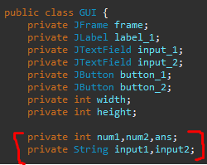
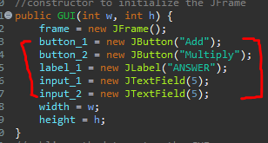
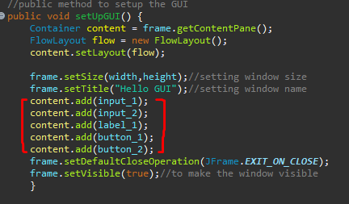
Adding and Multiplying two numbers in GUI
Declare variables Setup the components
Arrange your components

Slide 4
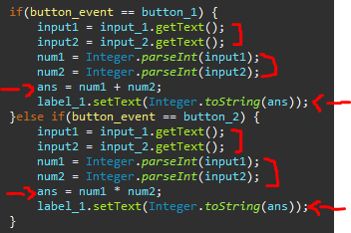
In your action listener assign the value of the JTextField to the declared string using getText() method
Convert the assigned values to integer.
Calculate the sum
Then Convert back the integer values to string and set the text to the Jlabel using setText() Method

Slide 5
Source Code
https://github.com/Jaeger47/IT123---Java-Examples/tree/main/JAVA%20GUI/%5B6%5DAdding%20%26%20Multiplying%202%20Numbers

Slide 6

Setting Background and Foreground Color on GUI components
Using setBackground() and setForeground() methods from swing class
Both receives color as parameter using the Color class
Color class has multiple static fields
Examples: black, blue, green, red and etc.
More info https://docs.oracle.com/javase/7/docs/api/java/awt/Color.html
Example Code

Slide 7
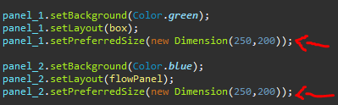
Setting size of GUI components
Using setPreferredSize() method from swing class
Receives dimension variable using the Dimension class

Slide 8
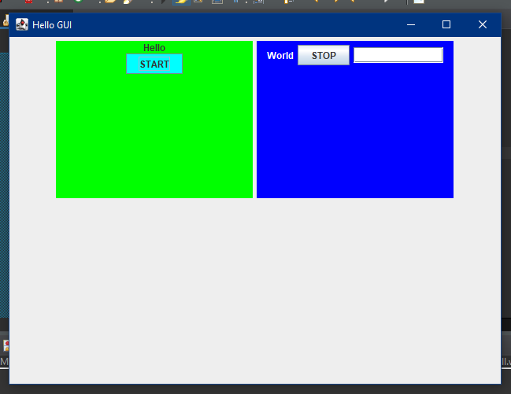
Using Multiple GUI Layouts
JFrame using FlowLayout inside a container, contain 2 JPanels
JPanel #1 using BoxLayout
JPanel #2 using FlowLayout

Slide 9
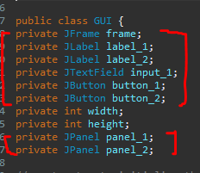
Implementation
Declare your components
JPanel - The JPanel is a simplest container class. It provides space in which an application can attach any other component. It inherits the JComponents class.

Slide 10
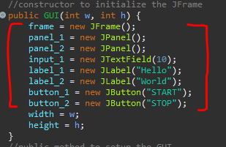

Initialize the components
Initialize a contentPane and add the main JFrame
Initialize all of the Layouts
FlowLayout has multiple parameter fields
CENTER, LEADING, TRAILING and etc.
More info: https://www.javatpoint.com/FlowLayout
Syntax: FlowLayout(FlowLayout.[field])
BoxLayout has multiple parameter fields
X_AXIS, Y_AXIS, and PAGE_AXIS
More info: https://www.javatpoint.com/BoxLayout
Syntax: BoxLayout([component],BoxLayout.[field])

Slide 11
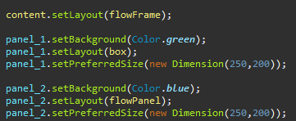
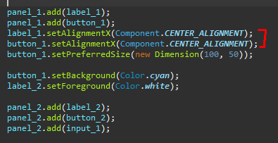

Setting up the Layouts
Setting the components to center
Adding the two JPanels to the Main JFrame

Slide 12
Result

Slide 13
Source code
https://github.com/Jaeger47/IT123---Java-Examples/tree/main/JAVA%20GUI/%5B7%5DMultiple%20Layouts

